Slide 1
The Charisms of the Holy sPirit

Slide 2
The Charisms of the Holy spirit enable you to ‘Live a life which cannot be explained unless God exists!’ (Cardinal Suhard)
Presented by
Fr. Gabor Czako
St. Peter’s & Sacred Heart rC Churches, Aberdeen

Slide 3
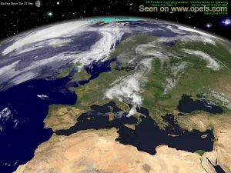
God created you for a unique purpose in life, a work of love that He longs to do through you!
This work of his love is a charism
(they are not the same as the 7 gifts which you received at baptism).

Slide 4
What are charisms?
Definition: ‘Special abilities/tasks’, given to Christians by the Holy Spirit to enable them to be powerful channels of God’s love and redeeming presence in the world.’ CCC 2003

Slide 5
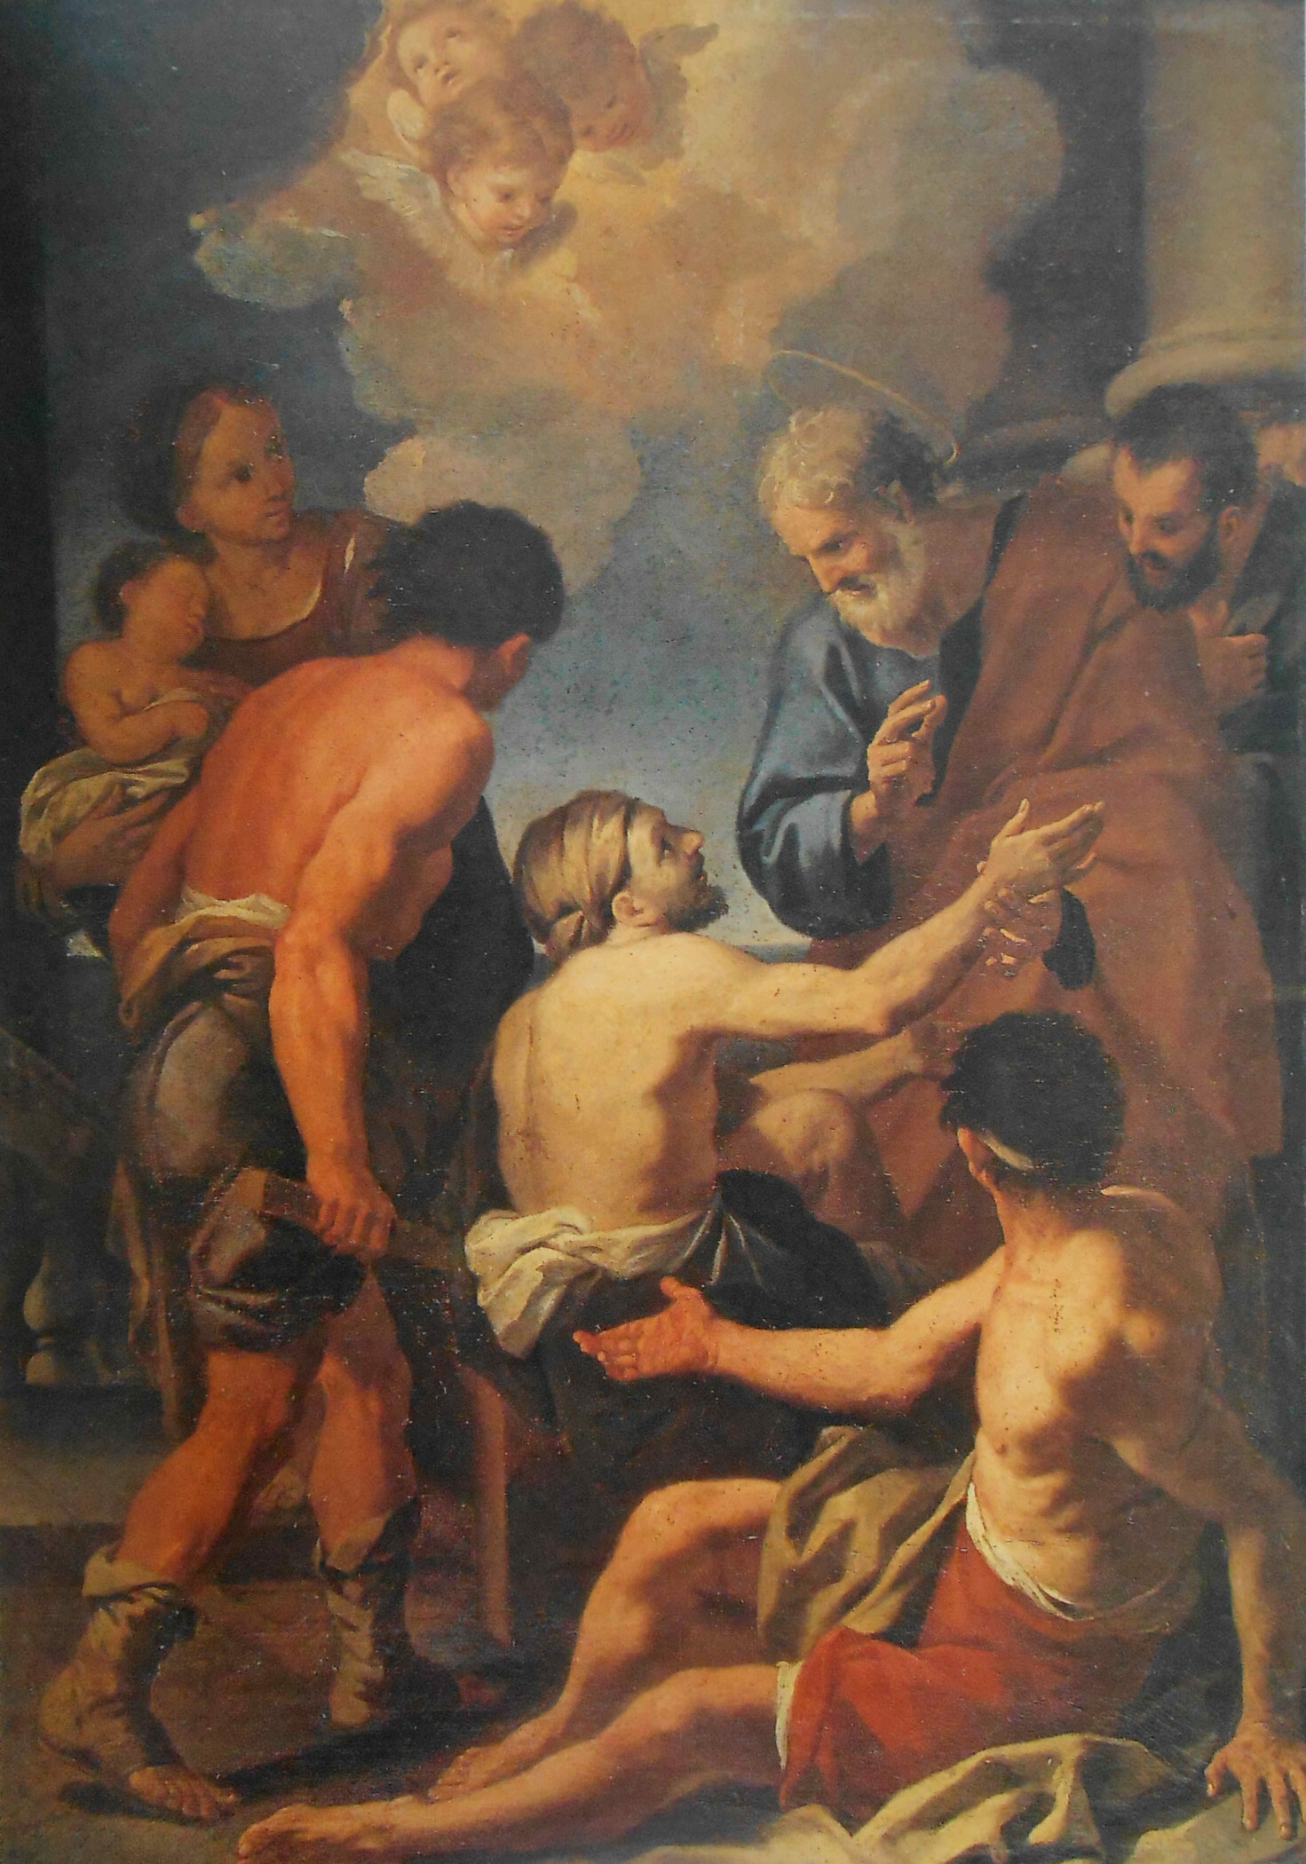
Examples: Charism of encouragement, healing, teaching, leadership, service, hospitality, etc.
Charisms are not natural Talents (but often build on natural talents, eg. charism of teaching builds on skills of teaching, charism of hospitality builds on skills of hospitality)

Slide 6
Cannot be inherited from our parents
Given by the Holy Spirit at our baptism/confirmation
Cannot be turned to evil
they can be developed

Slide 7
How do the charisms differ from the 7 gifts of the Holy Spirit?
While the 7 gifts are for the individual’s spiritual up-building, the Charisms are to be used to build up the church, and others.

Slide 8
Focused outward (Charisms are given for the sake of others: you are restless until you have used your charism)

Slide 9
Why are we not restless already?
There can be many reasons
Perhaps you are already using your charisms, and doing that specific work of charity which God wants to do through you, but you are not conscious of it.
You may be completely overwhelmed with some duties so much so that you don’t feel that restlessness anymore.
Some people get settled with doing certain things and are not willing to change.
There can be many other reasons as well.

Slide 10
They produce results above and beyond our ability (because they are God’s work of love)
eg. someone’s charism of hospitality gives visitors not only the feeling of being welcome and well looked after, but also a strong sense of God’s love and care so much so that people seek to be back to enjoy the hospitality of this person)

Slide 11
If we have a charism why do we not know them?
It is because most Catholics have never been taught about Charisms and their importance in building up the Church community.
Usually people were invited to do certain offices which we thought didn’t require the use of charisms (eg. Reading, Eucharistic ministers, altar service, secretarial work, welcome, etc.). Whoever was suitable for it and trained for it could do it.
But when you know how god wants to show his love through you, and you do that particular work of love (eg. welcome, administration, leadership, encouragement, healing, music, etc.) everything changes: what you do will have positive effect son people far beyond what you intended (because god will be working effectively through you).
SO it is absolutely necessary that all of you know and develop your charisms, just like your natural gifts.
Then you will know what your role is in the building and developing of the church community, according to what God wants to do through you, and not simply according to what gaps are in the church and who is trained to fill those gaps.

Slide 12
How many are there?
We don’t know exactly, but this course deals with 24 charisms. Romans 12, 1 Corinthians 12 and Ephesians 4 mention many of these.

Slide 13
Do all baptised Christians receive one?
Yes, according to Ephesians 4 and the Catechism (CCC 951). Most people receive two charisms, some even more. Some are given temporarily, some permanently.

Slide 14
Why is it important to know which of these charisms have I got?
They point towards your Christian vocation, mission in life. We all have received a mission in life, a work of love, to accomplish in Jesus’ way. Charisms are both important tools to accomplish this mission, and very importantly they point to what kind of service you can offer effectively for the up-building of the church community.

Slide 15
How to discern Charisms?
Fr. Gabor offers a Discernment course
Which covers the following
Which charism are there
Explore the whole idea of using a certain charism
How to Experiment with a Charism
Cannot be discovered in abstract
Use it and see what happens (2 hours/ week recommended, until you discover certain patterns that point to the presence of a charism: charism of service – try to serve others in some way every week)

Slide 16
4. how to examine your experience of using the Charism
Is it Energising?
Satisfying?
Joyful?
Feels like you ‘fit’?
Expresses your relationship with God (feels like prayer)?

Slide 17
4. How to Evaluate your experience
A charism does what it is meant for (if you have the charism of help, through your help others will succeed in the duty or task to which God has called them)
Mediocre or poor results on a regular basis are useful data (they indicate the absence of a charism)

Slide 18
5. The importance of feedback
- Ask people for Feedback, if they don’t give you
- People will sense your charism and will come to you even if you don’t know you have it
(eg. children in a primary school went to their teacher to ask for healing prayer, because they sensed her charism of healing; also people naturally open up to those who have the gift of encouragement)
- Direct feedback is what we are looking for (eg. feedback after using your charism)

Slide 19
How can the Called & Gifted 5 session course help me discover my charism?
It helps you to pinpoint the best place to start your discovery, which means it shows you what are the 6 most probable charisms that you have received from God. (It is like a SatNav, which shows where to go and how to get there, but you have to follow its instructions to get there.)
After the 5 sessions you need to get into groups and follow the Discerning Charisms Workbook, which will guide you through the rest of discernment
It takes time; weeks or months to pinpoint your Actual charism, because it is a gradual process of understanding how God regularly uses you for the building of his Kingdom.

Slide 20
Charism discernment requires perseverance and support!

