Slide 1
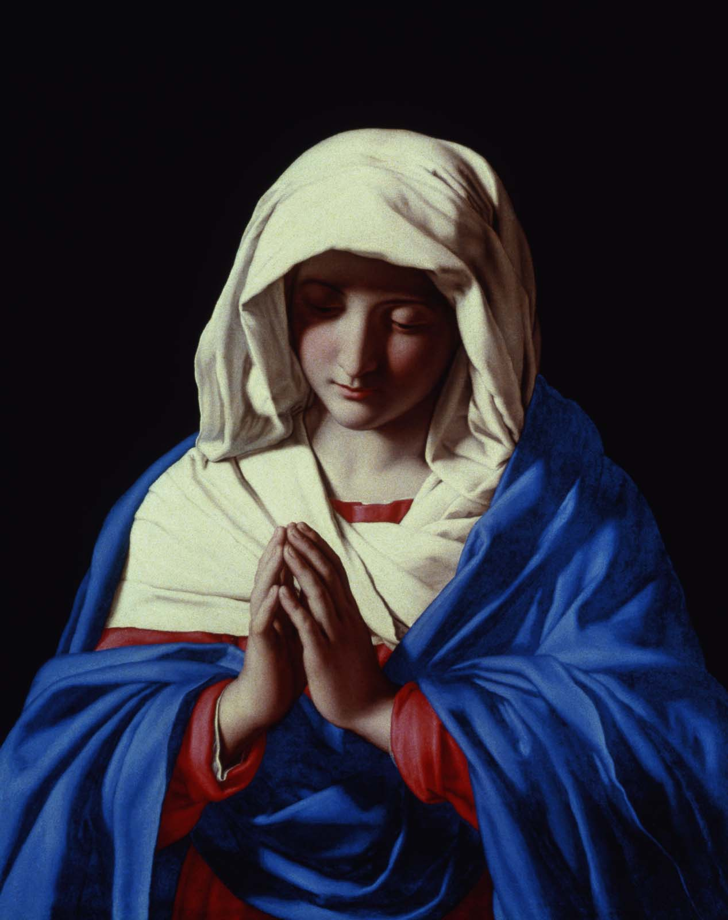
The seven gifts of the Holy Spirit (1)
The seven gifts of the Holy Spirit
The Virgin in Prayer by Sassoferrato
This reminds us that Mary was always filled with the gifts of the Holy Spirit.

Slide 2
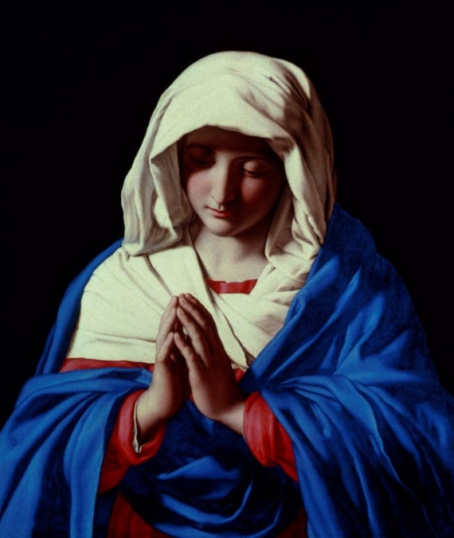
The seven gifts of the Holy Spirit (2)
The seven gifts of the Holy Spirit
Gifts for seeing in personal union with God |  | Gifts for acting in personal union with God
Wisdom | Counsel | Fortitude (Courage)
Understanding |  | Piety (Devotion)
Knowledge |  | Fear of the Lord (Awe)

Slide 3
The seven gifts of the Holy Spirit (3)
The seven gifts of the Holy Spirit
Gifts for seeing in personal union with God |  | Gifts for acting in personal union with God
Wisdom An illumination that enables a grasp of the ultimate realities of God and divine things. | Counsel To perceive the actions we must do in particular situations. | Fortitude (Courage) To have the strength and confidence to accomplish difficult actions.
Understanding To see the truth, meaning and implications of what God has revealed. |  | Piety (Devotion) To have familial respect for God, other persons and holy things.
Knowledge To see created things in their right relation to God (such as family life in God’s service). |  | Fear of the Lord (Awe) To have a holy fear of offending God because of our love of God.

Slide 4
Wisdom An illumination that enables a grasp of the ultimate realities of God and divine things. Enables us to see people, things and events with the eyes of God, because of our baptismal connection with Jesus, therefore we see how everyone and everything relate to the love and loving plan of the Holy Trinity, and to the Kingdom of God. (Cardinal Maria Martini)

Slide 5
Wisdom Seeking wisdom Ecclesiastes 7:25a: ‘I turned my heart to know and to search out and to seek wisdom and the scheme of things.’

Slide 6
Wisdom Listening to Wisdom Matthew 7:24-24 “Everyone then who hears these words of mine and does them will be like a wise man who built his house on the rock. And the rain fell, and the floods came, and the winds blew and beat on that house, but it did not fall, because it had been founded on the rock…”

Slide 7
Wisdom Christ is our true source of wisdom 1 Corinthians 1:28-31: ‘God chose what is low and despised in the world, even things that are not, to bring to nothing things that are, so that no human being might boast in the presence of God. And because of him you are in Christ Jesus, who became to us wisdom from God, righteousness and sanctification and redemption, so that, as it is written, “Let the one who boasts, boast in the Lord.”

Slide 8
Wisdom For reflection: Can you see your own life or a family member’s life from God’s angle? What difference does it make seeing difficult situations and difficult people with the eyes of God?

Slide 9
Understanding To see the truth, meaning and implications of what God has revealed. This gift helps us to understand the ways of God’s love both in Jesus’ life; ie. the relation between the Cross and God’s love, and in our lives today, how Jesus lives among us, and how the Holy Spirit works in us and through us.

Slide 10
It is the ability to grasp the meaning of the teachings of the Church. The gift of understanding helps you be tolerant and sympathetic of others. It helps you sense when someone is hurting or in need of compassion https://www.youtube.com/watch?v=8V7OYhsggn8&index=8&list=PL66250C3D9737F98D (1:11)

Slide 11
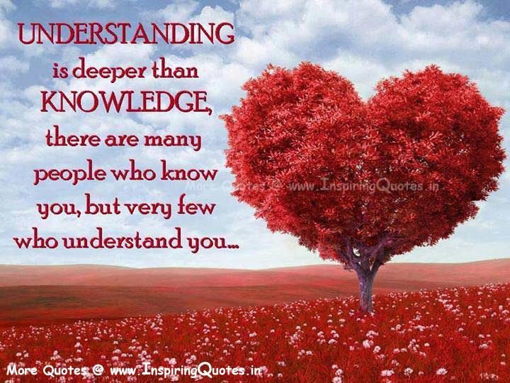
Understanding Isaiah 11:2: "The Spirit of the Lord shall rest upon him, the Spirit of wisdom and of understanding.“

Slide 12
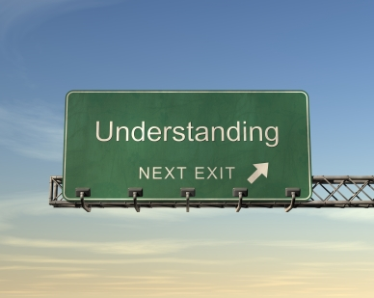
Understanding So this gift is about understanding the ‘know-how’ of God’s love. This gift is very important today when we are faced with atheism, secularism, religious indifference, suffering and persecution. https://www.youtube.com/watch?v=Zbv-Oe19O0s&list=PL66250C3D9737F98D&index=6 (1:02)

Slide 13
Knowledge To see created things in their right relation to God (such as family life in God’s service). It helps us to realise that in relation to God we are beloved instruments of His wonderful love. It directs us to glorify Him in every circumstances of life. Read Romans 12: 1 and 2 Cor 5: 20 St. Teresa of Avila says

Slide 14
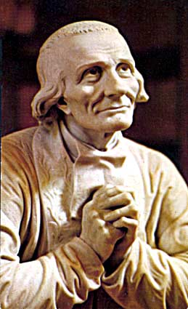
It is a more often found in the humble. ‘A Christian moved by the Holy Spirit knows how to make the difference. The eye of the world does not see further than this life, just as my eyes do not see further than this wall when the doors of the church are closed. But the eyes of the Christian see into the depths of eternity.’ (Jean-Baptiste-Marie Vianney, the Cure d’Ars) Let’s reflect on the above! https://www.youtube.com/watch?v=HfNTfX1d4JY&index=5&list=PL66250C3D9737F98D

Slide 15
Courage To have the strength and confidence to accomplish difficult actions. We are able to overcome our natural fear, for example David was not afraid of Goliath, or Jesus was not afraid of his unjust accusers, or people who saved the lives of others while risking their own. We have no fear of what is to come when it comes to doing God’s will.

Slide 16
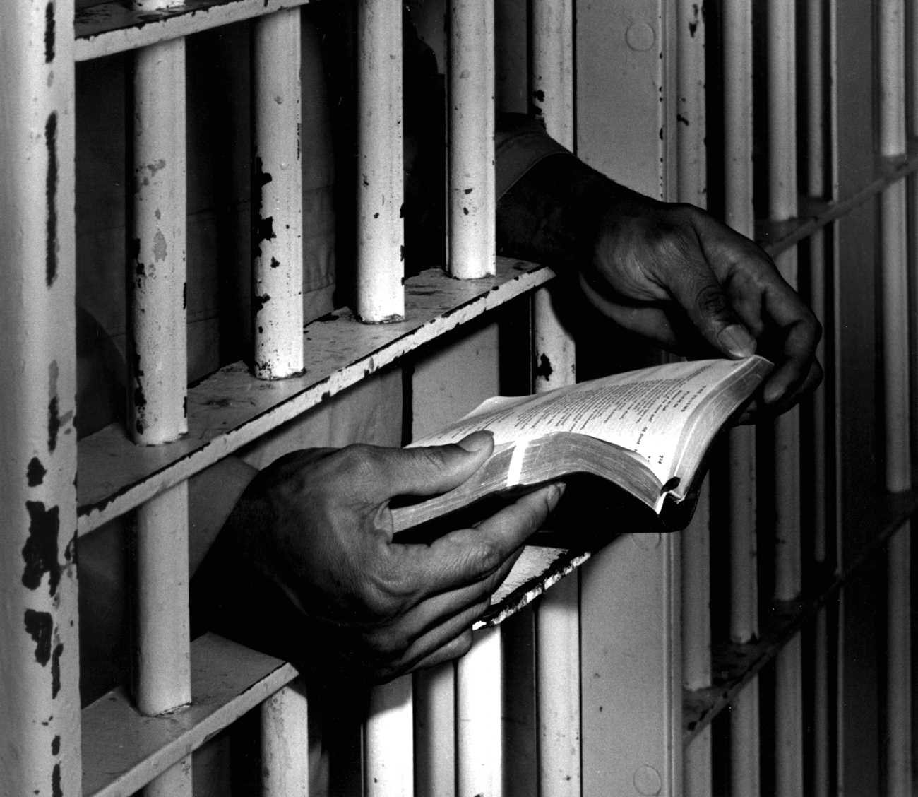
Courage Christians who were martyred recently by the IS terrorist organisation were all blessed with the gift of courage. Christians who do not give up their faith under persecution are all using the gift of courage.

Slide 17
Fortitude In what circumstances today do we need to pray for this gift? Read Hebrews 11:26-28 Matthew 24:13 Let us pray for the gift of Fortitude (0:16)

Slide 18
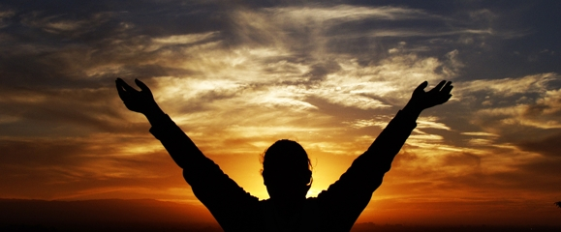
Piety (devotion) To have familial respect for God, other persons and holy things. In our relationship with God This gift - Gives us a taste for prayer - Makes us pray willingly and with enthusiasm - Makes a prayer come from the heart - Gives us the capacity to speak with God as a son or daughter, tenderly, to praise him and adore him

Slide 19
In our relationship with fellow human beings This gift - Makes us sensitive and attentive to each other, and helps us to deal with each other lovingly and with understanding - Helps us to see everyone as God’s child - Removes the thorns, shields us from blows, and smooths the rough corners of our relationships - Permeates child-parent, spousal, work colleague relationships, friendships, parish community relationships

Slide 20
Piety What does the 1st Commandment say? Psalm 150: 1-6: ‘Praise the Lord! Praise God in his sanctuary; praise him in his mighty heavens! Praise him for his mighty deeds; praise him according to his excellent greatness! Praise him with trumpet sound; praise him with lute and harp! Praise him with tambourine and dance; praise him with strings and pipe! Praise him with sounding cymbals; praise him with loud clashing cymbals! ..’ Matthew 6: 1-8 https://www.youtube.com/watch?v=oQvsX5wcATU&index=3&list=PL66250C3D9737F98D (0:59)

Slide 21
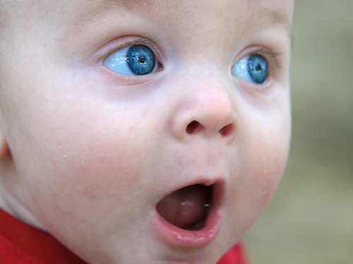
Guess what is the next gift! I give you a clue!

Slide 22
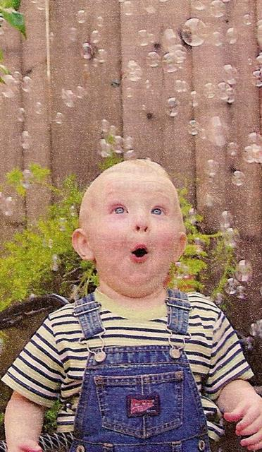
Fear of the Lord (Awe and Wonder) To have a holy fear of offending God, because of His love for us and our love of Him. Therefore this gift is - An attitude of great reverence and love out of knowing God’s love for us - A knowledge that God is a mystery who attracts and fascinates by love - A knowledge that God is a tremendous mystery who cannot be trivialised

Slide 23
Fear of the Lord (Awe and Wonder) - A combination of attitudes that enables us to overcome the banality, the superficiality, the haste with which, for example, we pray, enter into church or live as a Christian. Any thoughts about this? Let’s read Psalm 92

Slide 24
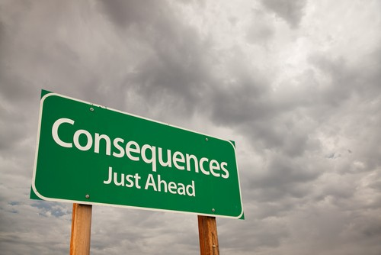
Counsel To perceive the actions we must do in particular situations. This gift is extremely important as life can be very confusing, and therefore we can hesitate with decision making and make the decisions that are not in accord with God’s plan. The gift of counsel helps us to make the right judgments and decisions promptly and with courage, in accord with God’s plan and our faith, and it cannot be explained without His intervention (supernatural).

Slide 25
Counsel - it is the perfection of the virtue of prudence - When one puts off decisions for a prolonged time, because one does not know what to do and prefers not to think about it, or hopes that someone else sometime will tell what to do, shows that the gift of counsel is lacking. - This gift comes with a sense of Joy, or energy, and enthusiasm or a courageous way of making judgements and decision. The beauty of this gift is that it forms personalities which are strong, tranquil and sure of themselves.

Slide 26
Counsel - Counsel builds on both wisdom, which allows us to judge the things of the world in light of our final end, and understanding, which helps us to penetrate to the very core of the mysteries of our faith. "the Holy Spirit speaks, as it were with the gift of counsel, to the heart and in an instant enlightens a person what to do," writes Father Hardon. It is the gift that allows us as Christians to be assured that we will act correctly in times of trouble and trial.

Slide 27
Bible - King David used the gift of counsel very effectively, so much so that the Kingdom of Judah and Israel was the strongest and most prosperous in his times, therefore he became the greatest King of the history of Israel - Isaiah 11:2 ’And the spirit of the Lord shall rest upon him: the spirit of wisdom, and of understanding, the spirit of counsel, and of fortitude, the spirit of knowledge, and of godliness.’ (Douay-Rheims Bible) https://www.youtube.com/watch?v=Dc74_-4krcs&list=PL66250C3D9737F98D&index=7 (1:04)

Slide 28
Let us pray Psalm 150

