Slide 1
Youth & their Family & the Church

Slide 2
Youth: teens

Slide 3
The Aim/Purpose of this discussion
To make our Church community GROW YOUNG
- In other words to make our Church
more youth and family friendly
- Let’s discuss how we will achieve this

Slide 4
What are we already doing for the Youth in Church?
Children’s liturgy (sporadically, not regular)
Children’s choir (Polish Mass)
Children’s song with acting (Polish Mass)
Catechism (St. Andrews Community)
Etc.??
Purpose of Youth ministry
- Happy youth (who know themselves, Christ, Church, Society, Creation)
- True sense of Identity (beloved children of God, with natural and supernatural gifts, charisms)
Belonging (to God’s family, and the created world)
Sense of purpose (aware of God’s purpose with their life = sense of ministry

Slide 6
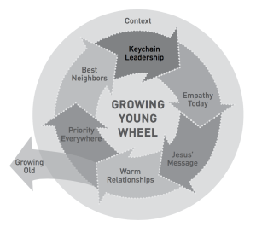
Six core commitments of Churches that are growing young

Slide 7
Six core commitments of Churches that are growing young
1. Unlock Keychain Leadership
Sharing Power with the Right People (incl. young people) at the Right Time
Churches that grow young are brimming with staff, volunteers, and parents who demonstrate keychain leadership. Whoever holds the keys has the power to let people in or to keep people out.
When we refer to keys, we mean the capabilities, power, and access of leaders that carry the potential to empower young people. By keychain leaders, we mean pastoral and congregational leaders who are acutely aware of the keys on their keychain; and intentional about entrusting and empowering all generations, including teenagers and emerging adults, with their own set of keys.
No matter your role, here is what we want you to know: if you are willing to entrust your keys to young people, they will trust you with their hearts, their energy, their creativity, and even their friends.
Spend time reflecting on powerful scriptural examples including Exodus 18:1–27; Joshua 1:1–18; 1 Samuel 8:1–22; Jeremiah 1:4–19; John 13:1–17; 15:1–17; 1 Corinthians 12:1–31; Ephesians 4:11–16; and Philippians 2:1–18.
Powell, Kara. Growing Young: Six Essential Strategies to Help Young People Discover and Love Your Church . Baker Publishing Group. Kindle Edition.

Slide 8
Six core commitments of Churches that are growing young
2. Empathise with Today’s Young People
When we talk about empathy, we mean feeling with young people.
Research Findings
Empathy Seeks to Understand Today’s Young People
Empathy Is Contagious
The Three Ultimate Questions of Every Young Person
Who am I?
Where do I fit?
What difference do I make?
The Young People You Know Experience These Questions Acutely
Powell, Kara. Growing Young: Six Essential Strategies to Help Young People Discover and Love Your Church . Baker Publishing Group. Kindle Edition.

Slide 9
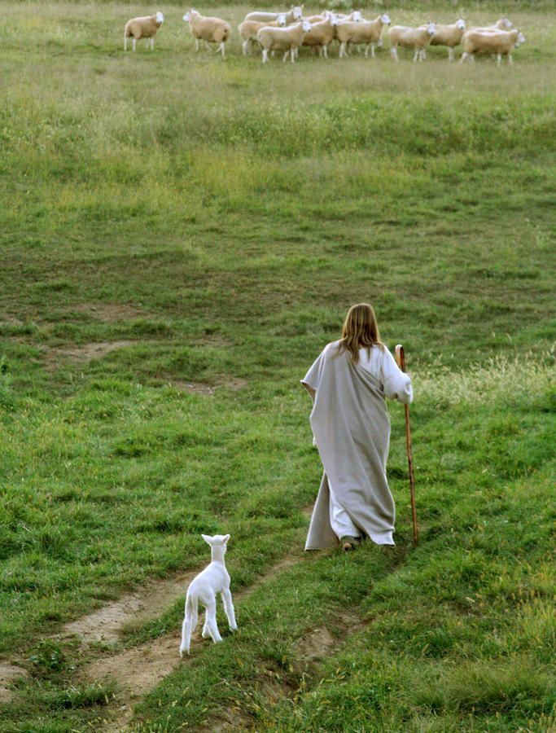
Six core commitments of Churches that are growing young
PERVASIVE STRESS (digital calendars jammed with extracurricular activities)
PERIPHERAL FAITH
DIGITAL TECHNOLOGY
SEXUAL EXPERIMENTATION
ADULT ABANDONMENT
I’m all for empathy, but what do I do when young people I know make choices thatWhile sometimes our best move is to stay quiet and pray, at other times, the most compassionate and supportive step we can take is to speak up. Based on the empathy we have seen in churches growing young, if you feel called to share your concerns, we recommend you follow this principle: first connect, and then correct. Embracing this approach with young people might mean you:
• Pay attention to how you are feeling before you talk with them. Are you nervous or scared? Do this young person’s choices surface old memories or wounds in your own life?
• Start your conversation by affirming what you appreciate about them.
Powell, Kara. Growing Young: Six Essential Strategies to Help Young People Discover and Love Your Church . Baker Publishing Group. Kindle Edition.

Slide 10
Six core commitments of Churches that are growing young
• Gently probe how they are feeling about the particular issue that concerns you, instead of diving into a lecture or tirade.
• Ask if they can think of any other ways they could respond to that issue.
• Help them explore the pros and cons of those potential responses.
• Share your concerns, and then ask what they think is wrong about any observations you share, as well as what may be right.
• Ask how you can help them make any shifts they desire to make.
• Shower them with the same response whether they don’t want to change, or try to change and fail, or try to change and succeed: unconditional love. Even—or maybe especially—when they disappoint you, please don’t be one more adult who makes them feel abandoned.
• Pray for them. And with them.
Powell, Kara. Growing Young: Six Essential Strategies to Help Young People Discover and Love Your Church . Baker Publishing Group. Kindle Edition.

Slide 11
Six core commitments of Churches that are growing young
Young People’s Winding Journey toward Purpose
- JADED REALISM
- CULTURAL PLURALISM

Slide 12
Six core commitments of Churches that are growing young
Ideas for action:
- Respond with Grace, Love, and Mission
We think that young people’s deepest questions about identity are best answered by God’s grace. We are convinced that teenagers’ and emerging adults’ need to belong is ultimately met through the unconditional love of community.
We believe their hunger for purpose is satisfied by being involved in God’s mission in the world.
- Rewind to Your Own Journey
Stereotype No More
When You See Something New, Confusing, and Maybe Even Offensive in Culture, Ask Why
Walk through Your Facility and Worship Service with the Eyes of a Young
Learn the Name of One Young Person . . . or Two . . . or Even Three
Dive Deeper with One Young Person
Support Marriages . . . Tangibly
Powell, Kara. Growing Young: Six Essential Strategies to Help Young People Discover and Love Your Church . Baker Publishing Group. Kindle Edition.

Slide 13
Six core commitments of Churches that are growing young
3. Take Jesus’ Message Seriously
What’s Young about the Good News
In churches growing young, Jesus reigns over poor theology, and his words ring true for young sojourners hungry for life-giving direction. Proclaiming Jesus as the centrepiece of the story of God and seeking to live out his message in everyday relationships, these churches are reclaiming the very heart of the Good News. One church growing young captures this proclamation through a mantra. Nearly everyone we interviewed—young and old—repeated,
“People are our heart; Jesus is our message.”
This is the foundation of their ministry.
Powell, Kara. Growing Young: Six Essential Strategies to Help Young People Discover and Love Your Church . Baker Publishing Group. Kindle Edition.

Slide 14
Six core commitments of Churches that are growing young
3. Take Jesus’ Message Seriously
Moralistic Therapeutic Deism (MTD) Still Threatens to Distract Young People from Jesus (avoid the ‘behaviour-focused’ gospel)
The Golden Rule Gospel Is Also Toxic to Faith
“Do to others as you would have them do to you” (Luke 6:31). In looking at young people’s tendencies to reflect Golden Rule language or themes, we found that those who profess this gospel show less faith maturity in general.
A More Robust Gospel Is Emerging in Churches That Grow Young
- Shift 1: Less talk about abstract beliefs and more talk about Jesus. Instead of simply agreeing with abstract theological truths, young people are drawn to the person and work of Jesus Christ.
Shift 2: Less tied to formulas and more focused on a redemptive narrative. narrative. Rather than insist the Good News is about specific words or linear steps to obtain salvation, young people use story language to describe God’s work in the world.
Shift 3: Less about heaven later and more about life here and now. Salvation means more to young people than the assurance of heaven later; it also invites us into a new way of life in the present.
Powell, Kara. Growing Young: Six Essential Strategies to Help Young People Discover and Love Your Church . Baker Publishing Group. Kindle Edition.

Slide 15
Six core commitments of Churches that are growing young
3. Take Jesus’ Message Seriously
Taking Jesus’ message seriously means churches pay attention to the life and words of Christ.
Young people can then articulate a gospel that is
less talk about beliefs and more talk about Jesus,
less tied to formulas and more focused on redemptive narrative,
and less about heaven later and more about life here and now.
- Young people want to know not only what they are saved from but also what they are saved for.
They want to take action, not just hear about what they can’t do.
Participation and challenge are two central features of churches growing young.
Challenge Is Not Something to Avoid
Young people appreciate challenging teaching in their church, even when it makes them feel uncomfortable and invites them to make changes based on Scripture’s teachings.
Vital factors to help young people share faith today include building authentic relationships, listening well, and being honest about questions and doubts.Powell, Kara. Growing Young: Six Essential Strategies to Help Young People Discover and Love Your Church . Baker Publishing Group. Kindle Edition.

Slide 16
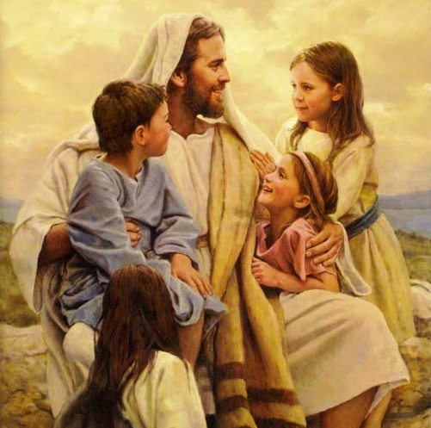
Six core commitments of Churches that are growing young
4. Fuel a Warm Community (Warm Is the New Cool)
Warmth is not about being nice and kind, but about being like a family
Other words describing warmth included welcoming, accepting, belonging, authentic, hospitable, and caring.
Warmth is often more attractive to young people than belief
Warm intergenerational relationships grow everyone young
Fostering Peer Friendships Fosters Spiritual Formation
Help Newcomers Land Smoothly—and Soon
• What is it like to walk into your building for worship or other ministries?
• How warmly are newcomers greeted? How are they oriented to the building and to the service or program?
- Pray Warmly
- Warmth is often slow. Really slow.
Powell, Kara. Growing Young: Six Essential Strategies to Help Young People Discover and Love Your Church . Baker Publishing Group. Kindle Edition.

Slide 17
Six core commitments of Churches that are growing young
4. Fuel a Warm Community (Warm Is the New Cool)
More than flashy worship, young people want authenticity and connection. When they talk about their churches, they talk about people and warmth.
Honest relationships and the ability to be real or authentic are not only preferences for young people; they also build stronger churches.
Powell, Kara. Growing Young: Six Essential Strategies to Help Young People Discover and Love Your Church . Baker Publishing Group. Kindle Edition.

Slide 18
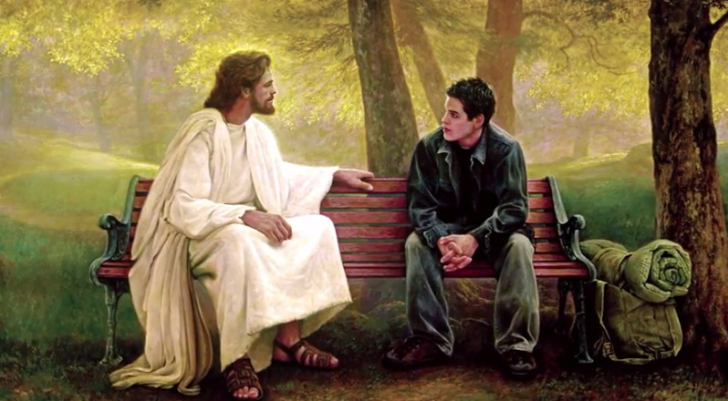
Six core commitments of Churches that are growing young
4. Prioritise Young People and families
Ideas for Action
1. Ask a simple question: “How could young people be part of this?”
2. Revisit Who Fundraises—and for What
Evaluate the fundraisers at your church. Who leads them? Whom and what do they benefit? Which fundraisers involving young people reinforce the church’s prioritization of them, and which ones might communicate that young people are on their own to raise money?
3. Address Family Pain and Brokenness through Support
This aspect of pastoral care often relies heavily on pastors, mentors, Sunday school teachers, and small group leaders, but we found congregations growing young offering more opportunities for support.
Powell, Kara. Growing Young: Six Essential Strategies to Help Young People Discover and Love Your Church . Baker Publishing Group. Kindle Edition.

Slide 19
Six core commitments of Churches that are growing young
4. Prioritise Young People and families
Churches that grow young emphasize young people in their overall philosophy, worship gatherings, staffing, and budget
Young people need load-bearing roles in the community, meaning they contribute through serving and using their gifts.
We Follow Jesus’ Lead When We Prioritize the Young
The disciples were used to Jesus going out of his way to heal children specifically (Mark 5:21–43; 7:24–30; 9:14–29). They had already been admonished by Jesus about the value of children, both in this world and in God’s kingdom, as he took a child in his arms and declared, “Whoever welcomes one of these little children in my name welcomes me; and whoever welcomes me does not welcome me but the one who sent me” (Mark 9:37).
Powell, Kara. Growing Young: Six Essential Strategies to Help Young People Discover and Love Your Church . Baker Publishing Group. Kindle Edition.

Slide 20
Six core commitments of Churches that are growing young
4. Prioritise Young People and families
4. Prioritise Partnering with Parents
The premise behind Orange is tied to the colour itself. When you take yellow, representing the light of Christ in the church, and mix it with red, representing the heart of the home, you get orange.
It requires intentional partnership that honours, equips, and helps parents to win in their own family’s spiritual formation.
Since parents are the greatest influence on their kids’ faith, the discipleship of adults has a direct impact on the discipleship of young people. So therefore offer parent training when it works for parents, and feature topics they care about.
Invite parents to volunteer in youth ministry.
5. Leverage Technology, but Don’t Obsess Over It (don’t just lament over the negative impact of technology on the youth, but get across your message to them using the same technology)
Powell, Kara. Growing Young: Six Essential Strategies to Help Young People Discover and Love Your Church . Baker Publishing Group. Kindle Edition.

Slide 21
Six core commitments of Churches that are growing young
7. Be the Best Neighbours
Churches that intend to be the best neighbours, and that train young people try to adhere to the example set by Jesus. In Matthew 22 when an expert in the law asks Jesus to identify the greatest commandment, Jesus replies by citing Deuteronomy 6:5: “Love the Lord your God with all your heart and with all your soul and with all your mind.” Moving beyond this familiar Jewish command, Jesus then adds a second “greatest” command that references Leviticus 19:18: “Love your neighbour as yourself.” For Jesus, love of God and love of neighbour are inseparable.
- both locally and globally.
- value both fidelity to Scripture’s commands for holiness and knowing and graciously loving their neighbours.
- navigating culture is one of their biggest barriers in ministering to young people.
show mercy toward the people outside our walls by adhering to the example set by Jesus in Matthew 22:34–40 and Luke 10:25–37.
honour what’s good, make the world better, and respect the journey as much as the destination. These congregations show a neighbour love that is greater than differences in ethnicity and socioeconomic status.
Growing Young: Six Essential Strategies to Help Young People Discover and Love Your Church . Baker Publishing Group. Kindle Edition.

Slide 22
Helping parents who have teenagers
Purpose of helping parents
to enable them to respond to challenges that pull their youth away from Faith/God/Church
1. PARENTAL INFLUENCE MATTERS MOST
This is true not only in childhood but also through adolescence. Research continues to affirm that the best predictor of a young person’s faith is the faith of their parents. That means the role of ministry leaders who care about kids also must include the care, equipping, and formation of parents and families.
“What I really like about our parish youth ministry is that they encourage the parents to come. They include the parents in all the classes that their kids are taking. There’s at least one meeting a week where the parents are invited to share in whatever is going on to deepen their faith as well as understand where their kids are coming from. I totally wish I had that when I was growing up.” —Alice, age 19
Parents’ participation in church worship and programming correlates with more mature faith in young people. But that’s not all. According to pastoral leaders, when parents are intentional about faith building outside of church, overall faith maturity and vibrancy within the congregation rises even more.
After young people graduate from high school, parents’ influence predictably wanes, but not as much as often thought. For 19- to 23-year-olds and 24- to 29-year-olds, parents’ participation in faith building outside of church ministries is still significantly correlated with faith maturity.
Powell, Kara. Growing Young: Six Essential Strategies to Help Young People Discover and Love Your Church . Baker Publishing Group. Kindle Edition.

Slide 23
Helping parents who have teenagers
Purpose of helping parents
2. PARENTS NEED SUPPORT
Daily: Each day from Monday through Friday, the staff members set calendar reminders to stop and pray for five minutes for parents. Five minutes may not sound like much, but our leaders confessed that before the cues, they hardly prayed for parents at all.
Weekly: The team agreed to communicate with all parents directly once each week in some way—most often through a weekly email to parents—and to communicate with various parents individually through occasional calls, texts, and meetings. This commitment included a promise to respond to parent emails and phone calls within 48 hours.
Monthly: Parent training had been scattered and inconsistent at our church, so the team built a monthly rhythm of resourcing parents directly. Using a variety of means, they offer training parents can access more readily: an online article one month, a parent book club another, and occasionally an in-person training seminar.
Powell, Kara. Growing Young: Six Essential Strategies to Help Young People Discover and Love Your Church . Baker Publishing Group. Kindle Edition.

Slide 24
Helping parents who have teenagers
Purpose of helping parents
The Effects of Divorce Require Our Attention
Divorce leaves kids permanently conflicted, ping-ponging back and forth between parents in a game they never wanted to play. They end up feeling like they partially belong in both parents’ worlds, meaning they fully belong in neither. For young people from intact families, special events such as birthdays, holidays, and graduations enhance a sense of belonging. For teenagers and emerging adults from divorced families, these same events heighten the tensions of standing with one foot in each parent’s world. Lacking a secure sense of belonging at home, children of divorce are three times as likely to feel alone, twice as likely to feel unsafe, and almost four times as likely to disrespect their parents. As they age, young adults from divorced families tend to have higher rates of alcohol and drug use, do more poorly in school, and are more likely to be depressed and withdrawn.
As a young person’s fabric of family is ripped apart, the faith community has the opportunity to weave itself into a young person’s relational network. More often than not, we fail to do so.
An 18-year-old African American woman shared a testimony in worship when our team visited her church. She began by explaining that she has two families—her biological family and her church family. Through tears, this high school senior shared about her parents’ divorce and resulting pain that contributed to deep struggle. She called out areas where she felt like the church had failed her but also ways they valued her and walked with her. Most notably, she treasured how members of the community saw “something in me I didn’t see in myself.” Like the pastor who invited her into a leadership role, and the group of women who moved from being acquaintances to adoptive aunts. The congregation did not sit silently during this testimony. Vocal support emanated from the people as they encouraged, “You can do it,” “Come on,” and “We’re here for you.” It was clear they knew, loved, and were committed to this young woman. By the end of her story, tears flowed around the room.
Powell, Kara. Growing Young: Six Essential Strategies to Help Young People Discover and Love Your Church . Baker Publishing Group. Kindle Edition.

Slide 25
Helping parents who have teenagers
Purpose of helping parents
The Effects of Divorce Require Our Attention
Divorce leaves kids permanently conflicted, ping-ponging back and forth between parents in a game they never wanted to play. They end up feeling like they partially belong in both parents’ worlds, meaning they fully belong in neither. For young people from intact families, special events such as birthdays, holidays, and graduations enhance a sense of belonging. For teenagers and emerging adults from divorced families, these same events heighten the tensions of standing with one foot in each parent’s world. Lacking a secure sense of belonging at home, children of divorce are three times as likely to feel alone, twice as likely to feel unsafe, and almost four times as likely to disrespect their parents. As they age, young adults from divorced families tend to have higher rates of alcohol and drug use, do more poorly in school, and are more likely to be depressed and withdrawn.
As a young person’s fabric of family is ripped apart, the faith community has the opportunity to weave itself into a young person’s relational network. More often than not, we fail to do so.
An 18-year-old African American woman shared a testimony in worship when our team visited her church. She began by explaining that she has two families—her biological family and her church family. Through tears, this high school senior shared about her parents’ divorce and resulting pain that contributed to deep struggle. She called out areas where she felt like the church had failed her but also ways they valued her and walked with her. Most notably, she treasured how members of the community saw “something in me I didn’t see in myself.” Like the pastor who invited her into a leadership role, and the group of women who moved from being acquaintances to adoptive aunts. The congregation did not sit silently during this testimony. Vocal support emanated from the people as they encouraged, “You can do it,” “Come on,” and “We’re here for you.” It was clear they knew, loved, and were committed to this young woman. By the end of her story, tears flowed around the room.
Powell, Kara. Growing Young: Six Essential Strategies to Help Young People Discover and Love Your Church . Baker Publishing Group. Kindle Edition.

Slide 26
What about kids whose parents don’t come to church?
For teenagers who make their way into church without their parents, often the church body becomes a surrogate faith family, providing spiritual nurture that may be missing at home.
While this ministry is admirable, churches often miss opportunities to connect with those parents on the fringes.
Research advisor Reggie Joiner, founder of Orange and the ReThink Group, says that the vast majority of the time, those parents—like all parents—love their kids and want to do right by them. So a first step toward prioritizing families outside the church is to start with the assumption that they love their kids more than we love their kids.
Then we make it our job, not theirs, to reach out and initiate relationship. Once we have relationship, we build understanding and empathy toward parents, which eventually nurtures trust, which in turn can slowly open doors for deeper connection.
Powell, Kara. Growing Young: Six Essential Strategies to Help Young People Discover and Love Your Church . Baker Publishing Group. Kindle Edition.

Slide 27
Methodology
PLAN/ ACT/ PERSEVERE
Aim for Adaptive Change in Order to Grow Young
adaptive challenges involve shifts in attitudes, values, and behaviours
It requires leaders to learn new ways to solve problems.
Example: Adaptive work is more like trying to convince someone to stop smoking. A doctor can provide guidance about the risks and suggest ideas that might help the person stop smoking, but they cannot stop smoking for the person. The ultimate decision depends on a major modification of the values and behaviours of the smoker. Applying this principle to organizations, Heifetz writes, “The single most common source of leadership failure we’ve been able to identify—in politics, community life, business, or the non-profit sector—is that people, especially those in positions of authority, treat adaptive challenges like technical problems.”
Most of the important obstacles faced by churches that want to grow young involve a shift in the attitudes, values, and behaviors of the people in the congregation.
Powell, Kara. Growing Young: Six Essential Strategies to Help Young People Discover and Love Your Church . Baker Publishing Group. Kindle Edition.

Slide 28
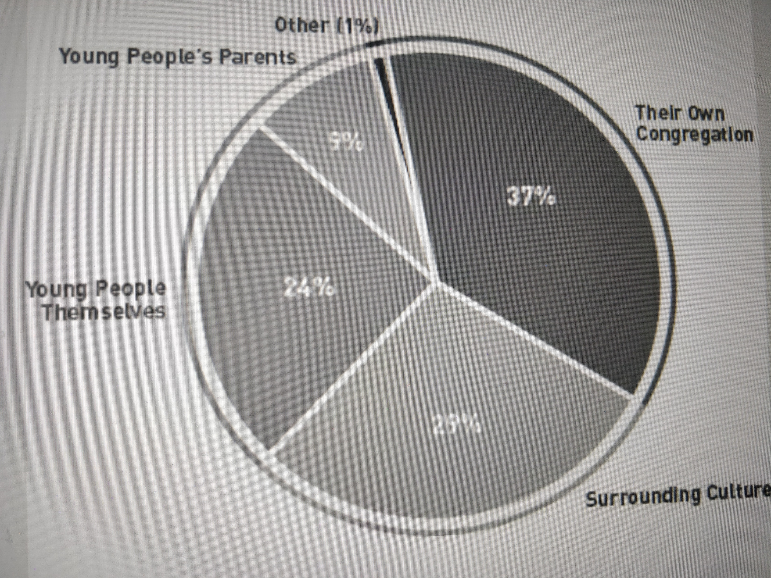
Challenges
IN REACHING YOUNG PEOPLE
TOP CHURCH-RELATED CHALLENGES (ranked in order)

Slide 29
Planning for Change
Step 1
LISTEN to young people/families
Step 2
Create a shared story VISION
Step 3
Develop a PLAN for change

