Slide 1
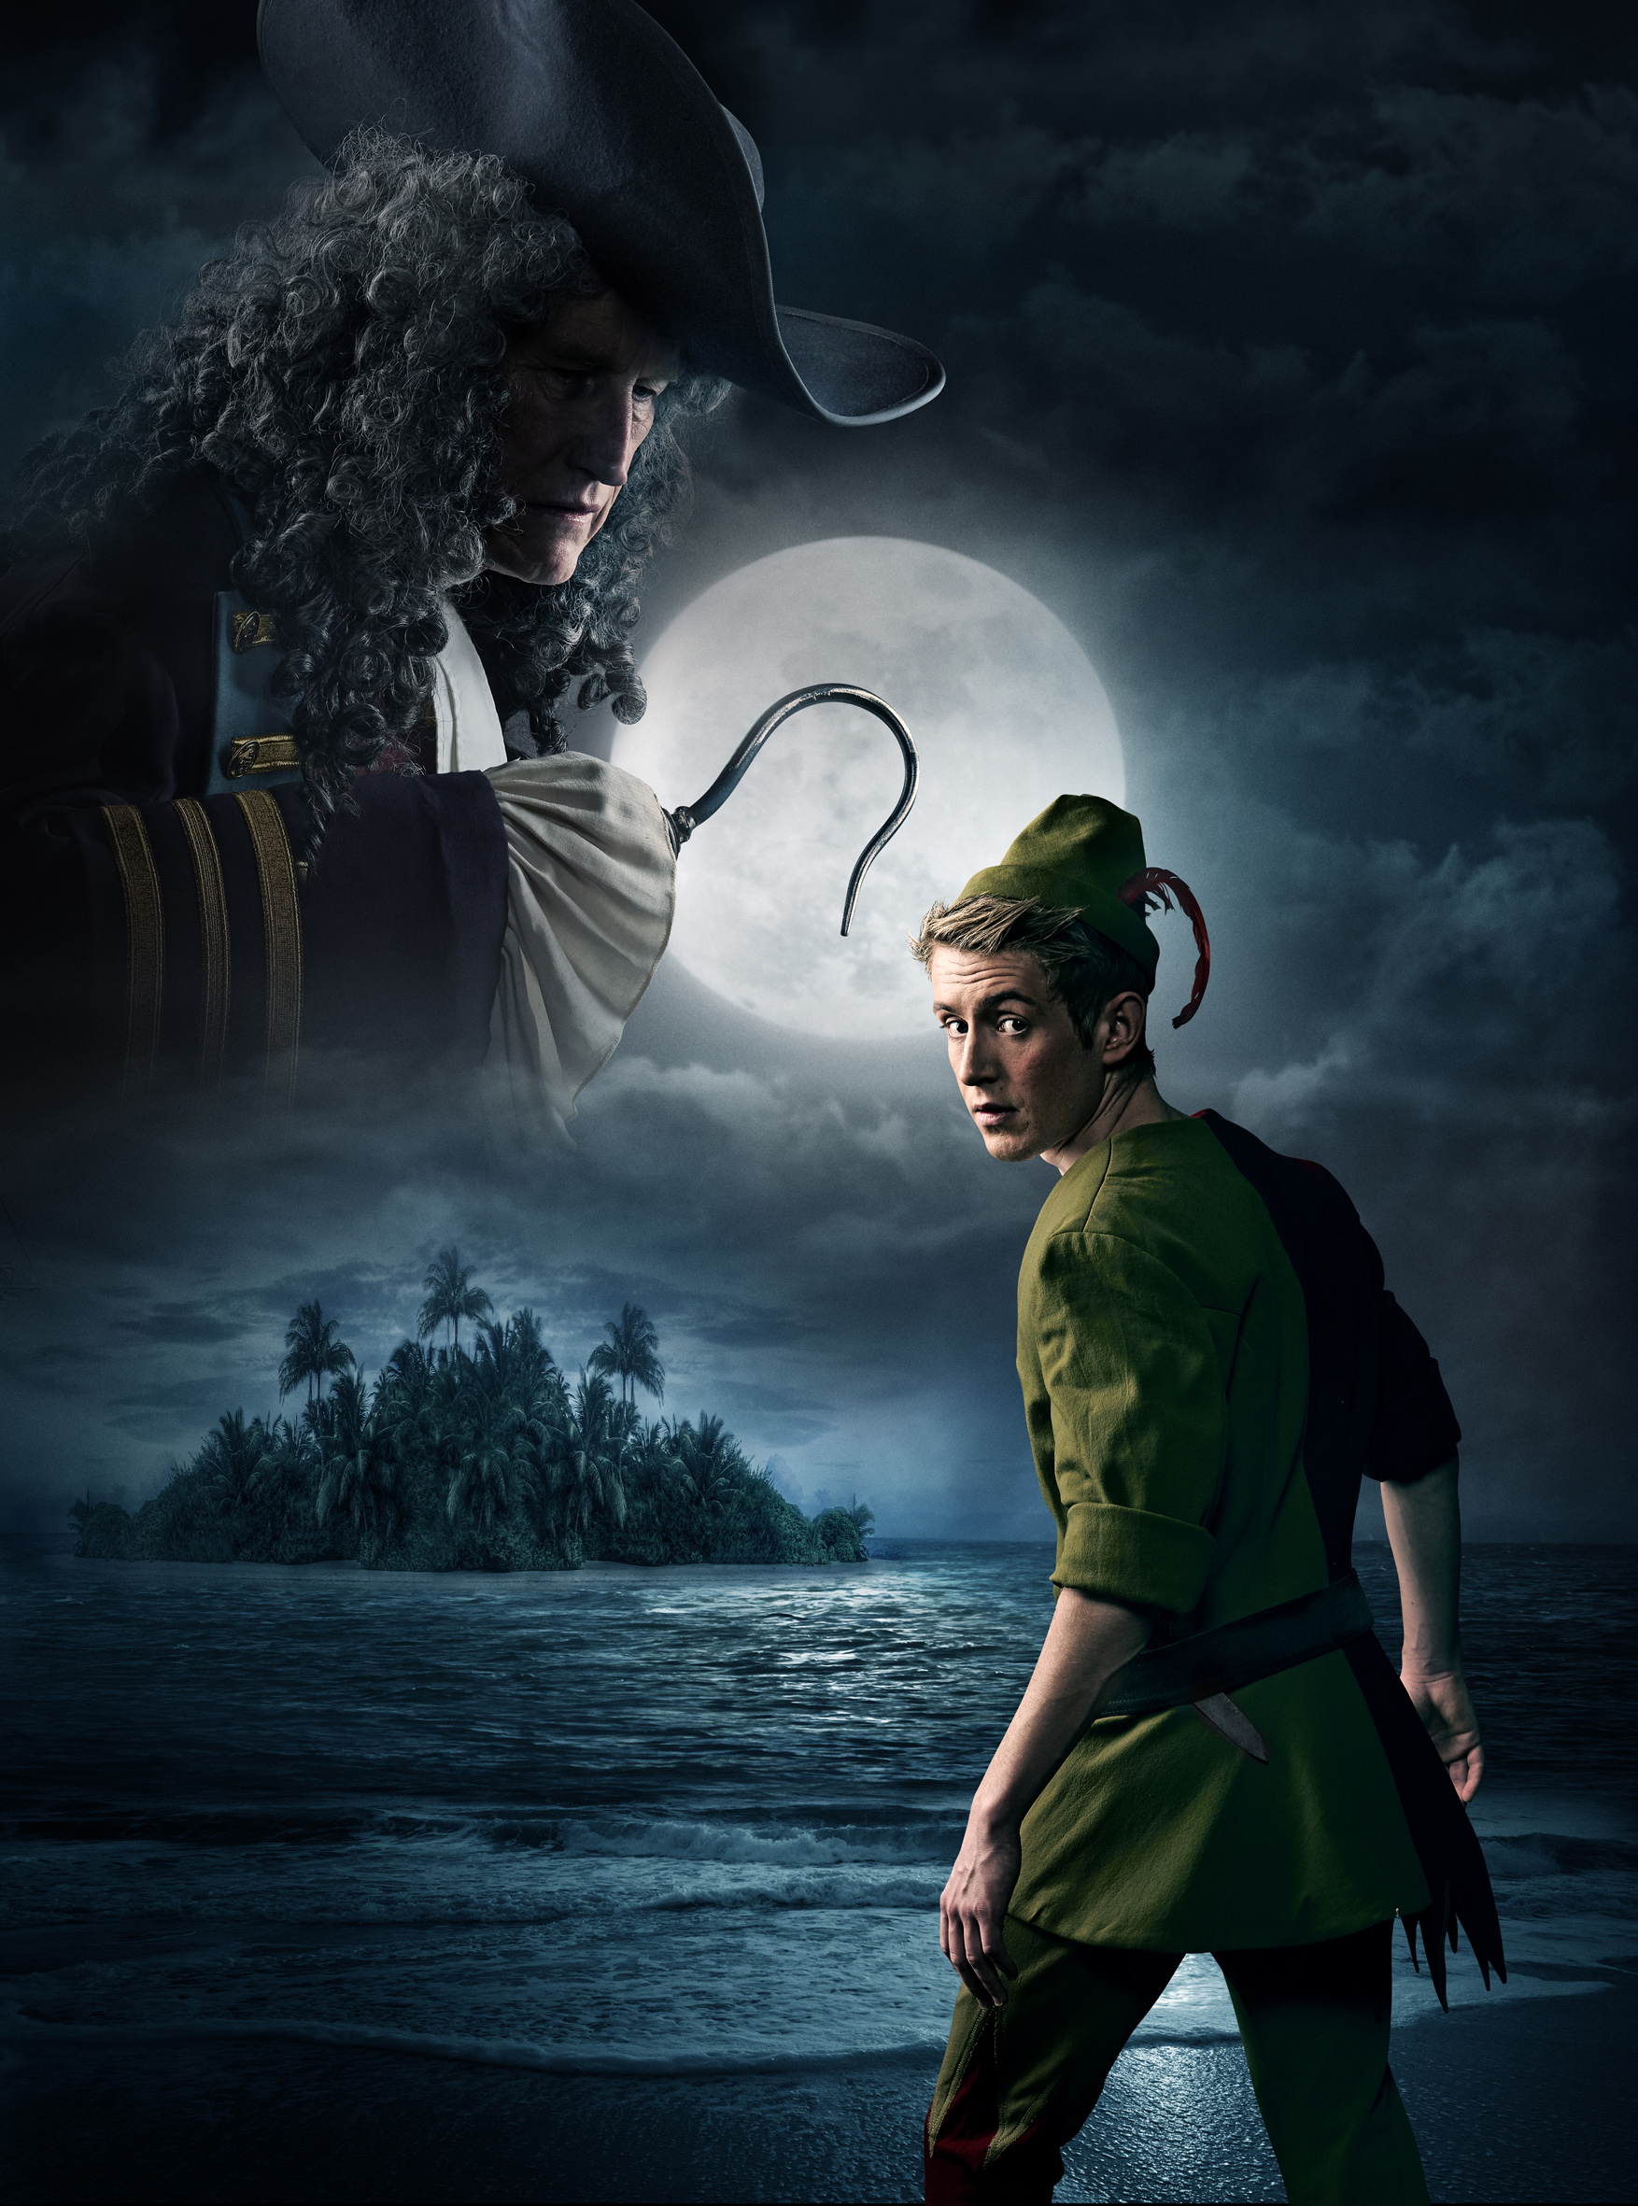
5th I receive blessing in the name of JEsus/ PrzyjmuJę błogosławieństwo w imię Jezusa
Discovering your identity
God wants you to receive his blessing
Tempting spirits want to rob you of your identity and destiny, by putting lies into your thoughts about you and God and His relationship to you.
But God wants to affirm your true identity
Family problems (drugs, alcoholism, constant argument between parents, etc.) in childhood or later on can your true identity or prevent its development, e.g. these may give you an impression that you are not wanted or not important, filthy, or a failure, etc. God was there, but perhaps your spiritual eyes were clouded because of the trauma or other negative childhood experiences.
Therefore you need to discover your true identity, the way God sees you and treat you, just as any parent should consider and treat a child.

Slide 2
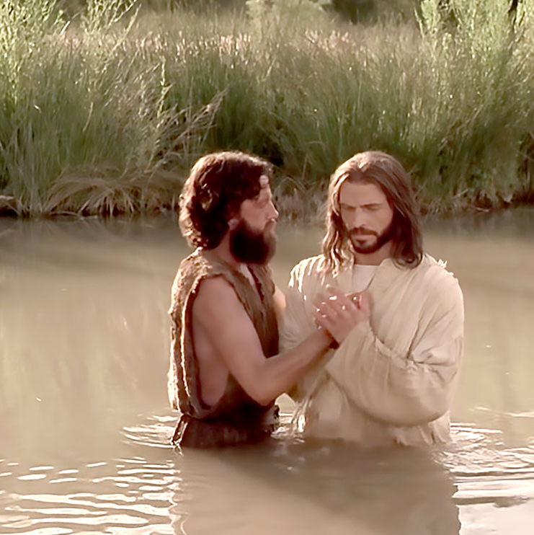
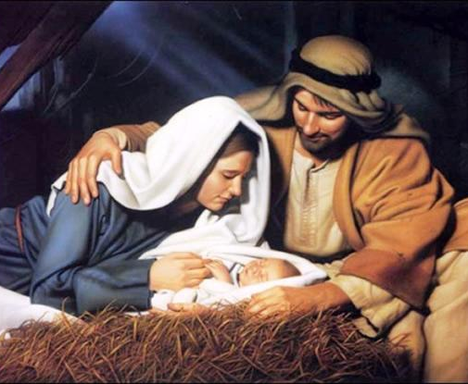
5th I receive blessing in the name of JEsus/ PrzyjmuJę błogosławieństwo w imię Jezusa
God intended family life, prayer and sacraments as protective walls against the enemy and as sources of His blessings.
So God wants to affirm your true identity
From the Father Jesus received special blessings of His identity and destiny at His conception, during His time in the womb, at His birth, through His circumcision/dedication, at His baptism and at the major points in His life, prior to going to the cross.
Once you have surrendered your life to God the old is gone the new has come. Through faith and baptism you have died and surrendered your life to God and now you live for him. So your New identity is found in Christ .
Ask for the Father’s blessing: The good news is that God wants to bless you much more than you desire.
Prophetic blessing: It has 2 basic characteristics - one that God speaks and - secondly prophetic blessing speaks right into the person's heart
God revealing his Kingdom and love : He is always there with you, even when you don’t realise it.

Slide 3
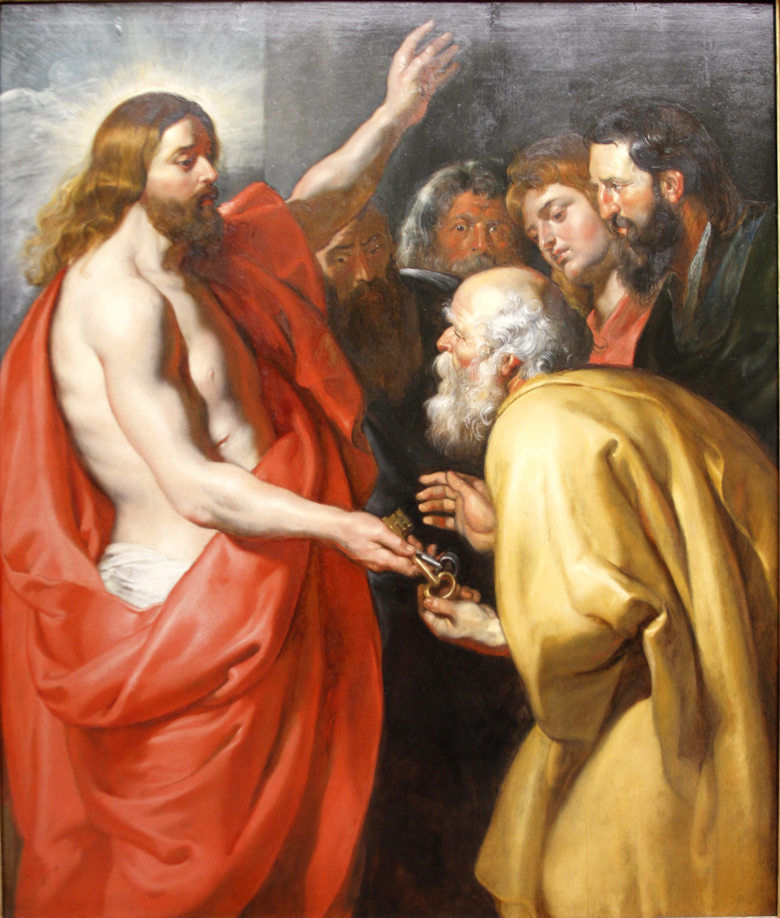
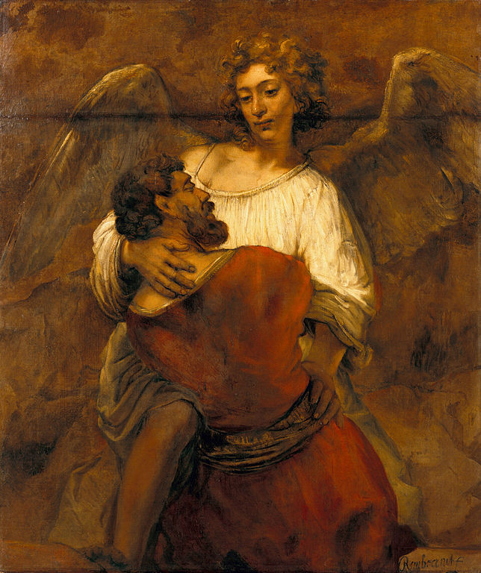
5th I receive blessing in the name of JEsus/ PrzyjmuJę błogosławieństwo w imię Jezusa
God knows you personally. He knows you by your name. He speaks to you through others, sometimes. The way you know that, is that He addresses things deep inside you. Jeremiah 29:11: “‘For I know the plans I have for you,’ declares the LORD, ‘plans to prosper you and not to harm you, plans to give you hope and a future.’” To bless with such power is to empower someone for life’s journey.
Names speak to your identity; Abram > Abraham; Simon > Peter, Jacob > Israel; Jesus = God saves; When you pray for someone his/her name reminds you of their identity. In Isaiah 43:1 God addresses His people: “Fear not, for I have redeemed you; I have summoned you by name, you are mine.” God has assigned meaning and purpose to your name. It represents you. He loves your name. He loves to speak it. He knew your name before you were born, even before your parents spoke it.
God wants to speak to you regularly about our identity in Him.

Slide 4
5th I receive blessing in the name of JEsus/ PrzyjmuJę błogosławieństwo w imię Jezusa
God wants to break into your lives and reveal that He is your Father. He wants to affirm our identity and destiny. We need to be blessed in order to succeed in life. Blessing is the spiritual bread you need for your life’s journey.

Slide 5
Staying free and going deeper/ Schodzenie w głąb
If you want to walk in freedom and blessing, there needs to be a change in the way you think and live, a change that builds on freedom. There are several ways to lose the freedom you have won, and Jesus' parable about the sowing of seeds explains this. However, be a good soil for the seed, so that it can take deep roots in you (p.123).
Lesson points to stay free
1. You have to defend the territory of your life which has become free.
2. Do not become introspective, because it puts emphasis on you, rather than Jesus. So when you sense a destructive pattern in your thinking bring it first to Jesus and then to your friend or priest.
3. Pride is your biggest enemy, so humble yourself before God.
4. Liberation’s ultimate purpose is the advancement of the Kingdom of God, and not to have big experiences or a magic formula for true freedom. So do not try to avoid the crosses of Jesus after liberation. Suffering is part of being human. James 1:2: ‘Consider it pure joy, my brothers and sisters, whenever you face trials of many kinds'.

Slide 6
Staying free and going deeper/ Schodzenie w głąb
Liberation/deliverance is an ongoing process: we need to surrender more and more parts of our lives as we discover new bondages. Janet's story is a good example (p. 128)
Patterns of thinking and acting (e.g. by parents) and the spirits associated with those patterns can be passed from one generation to the next. Gaining victory in your lives helps not only you, but also those who come after you, like your children, but victory over evil is not enough, you also have to think and act in a new way.
When a person seeks to follow the Lord, every fall can become a greater victory. The process of falling and getting up again can bring greater conviction and seriousness about living a committed Christian life. It can bring deeper humility and acceptance of your dependence on God.
Support is important; someone with whom you can be honest and with whom you can live in the light/freedom. If you don't have one, ask the Lord for one.

Slide 7
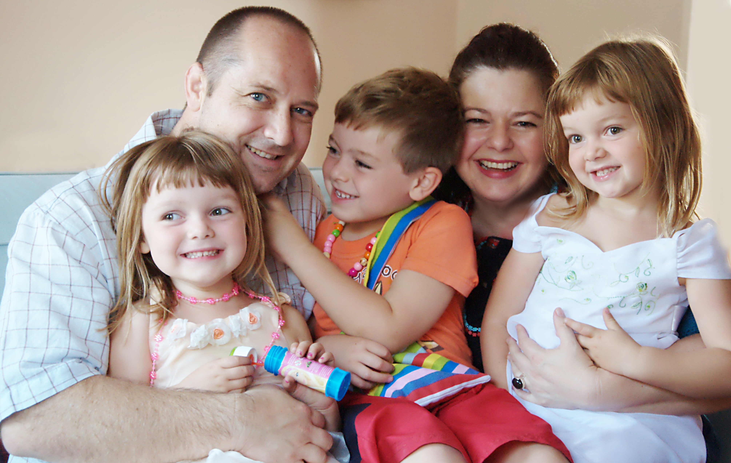
Staying free and going deeper/ Schodzenie w głąb
We are transformed by the renewal of our minds (Romans 12:2). It is a gift to know your weakness, because then you know what areas of your life to protect from the temptations of bad spirits.
The God-given protections are a healthy pattern of family life, church life, etc.

Slide 8
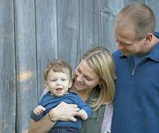
Bread for A Friend/ chleb dla przyjaciela
If you wan to help others to be set free, you need to learn what it means to weep with the Lord’s compassion, to listen without judgment and to empathize without needing an answer.
To be blessed and be able to enable others to be blessed you need to receive the Father's blessings (our daily bread).
Parents can act as intercessors for the liberation/setting free of their children. They just have to have a faith, which is stronger than their own pride (see story of the woman of the demoniac girl: dogs and crumbs story)
Receiving unbound ministry is only the beginning of your liberation; you can continue with helping others to be free.
We know the real value of what we have received (eg. liberation) until we pass it on (like helping others to be set free).

Slide 9
Bread for A Friend/ chleb dla przyjaciela
Father thank You for the many keys to freedom You have given me in Your Son. Your love has set me free. I want to be Your disciple, an instrument for Your love to others. Truly Your love flowing through me is my liberation, the final key. Lord, give me that gift of love.

